Slide 1
FRAMEWORKS

Slide 2



Slide 3
OVERVIEW

Slide 4
OVERVIEW
Background
File setup
Templating engine
Event handling
Life Cycle functions
Vue, React, Angular

Slide 5
THE PROBLEM
It can be very hard to maintain applications that are built with a series of hard coded vanilla HTML/CSS/JavaScript pages.
For instance, if the app uses the same banner bar on the ‘about’ page and ‘user’ page, that banner bar would need to be hard coded twice, making it very difficult to make consistent changes during development.
Furthermore, getting and setting values using .getElementById() to achieve two directional binding on input controls would be very tedious and repetitive on an application. Similarly, HTML elements that need to repeat based on an array structure, or HTML elements that need to hide based on certain variables is not something easily achieved with vanilla JavaScript.

Slide 6
THE SOLUTION
To resolve these issues, companies began building frameworks, so serve as a higher level programming language to web development.
The idea was to design a method of easily programming frequently used properties on an app, such as repeaters, binds, and component re-usability.
Frameworks evolved from visual basic, web forms, and SPA frameworks.
There have been many initiatives in the 2010s to transition legacy web forms into SPA frameworks.
The ability to use front-end frameworks have become an essential skill for most software engineers.

Slide 7
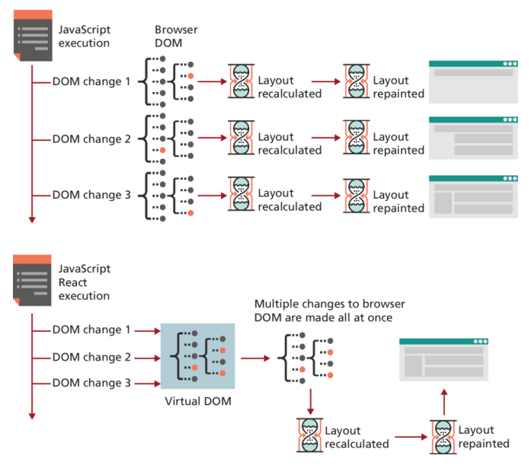
THE SOLUTION
Frameworks help simply the process of creating user interfaces.
They use virtual DOMs that manipulates code, improving the execution speeds of DOM traversals.
They allow apps to built as a series of components.

Slide 8
WEB FORMS
In the early 2000s, Microsoft made an attempt to build a framework that allowed programmers to build applications that can be deployed on the internet.
They called this new framework, Web Forms, and used a similar architecture to VB.
Web Forms was a step above VB because it included added functionality for the client-server model, taking advantage of HTML, CSS, Javascript, C#, and SQL into a graphical user interface similar to VB.

Slide 9
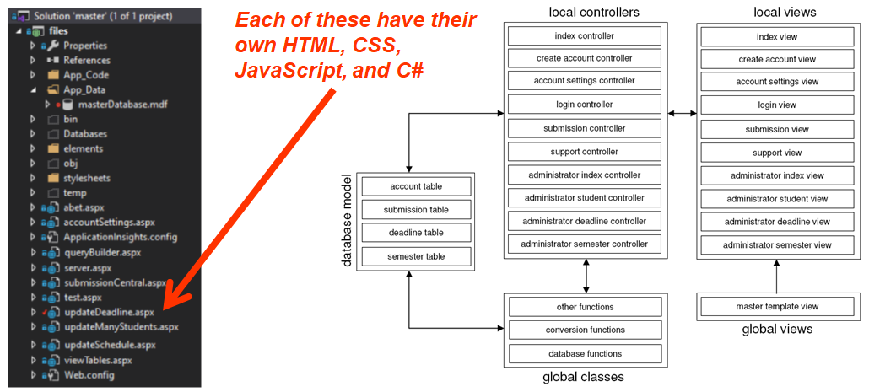
WEB FORM ARCHITECTURE

Slide 10
SINGLE PAGE APPLICATIONS(SPA)
The problem with Web Forms is that they were slow, because every page was treated like a new website.
This is why the Single Page Application(SPA) framework was introduced in the mid 2000s. This architecture uses a powerful framework that can combine and merge components into a single HTML element of a page that gets re-written locally on a needed basis, instead of doing a fresh reload. This significantly increases the speeds of running an app.
These SPA frameworks include React, Vue, or Angular.
These frameworks have become increasingly popular on many job descriptions.

Slide 11
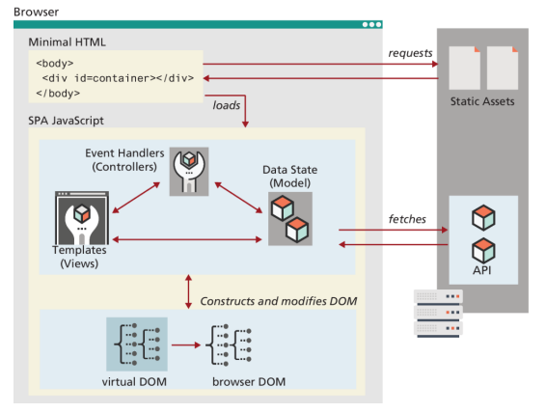
SINGLE PAGE APPLICATIONS(SPA)
SPAs use minimal HTML.
They use JavaScript instead to populate the HTML using logic from the framework and data pulled from an API.

Slide 12
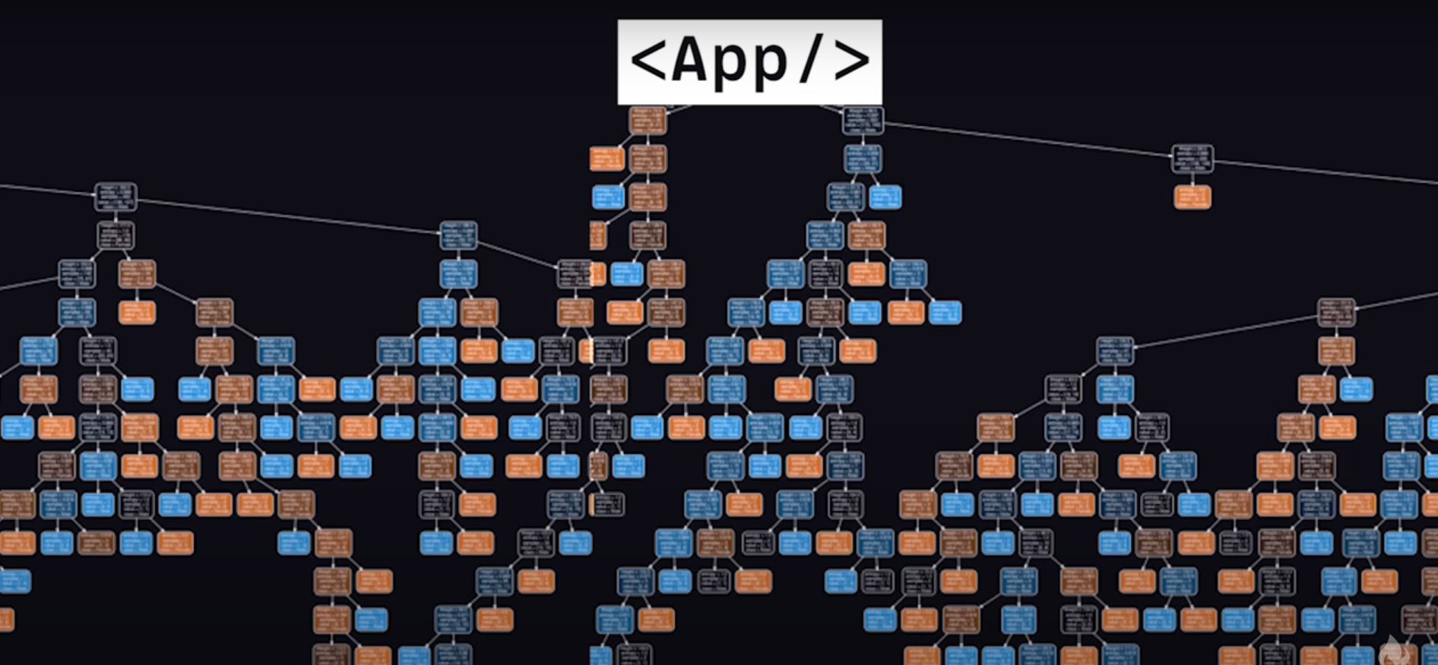
THE COMPONENTS OF AN APP CAN BE ENDLESS
It’s common to use tools like Storybook.js to isolate components for testing and showcasing purposes.

Slide 13
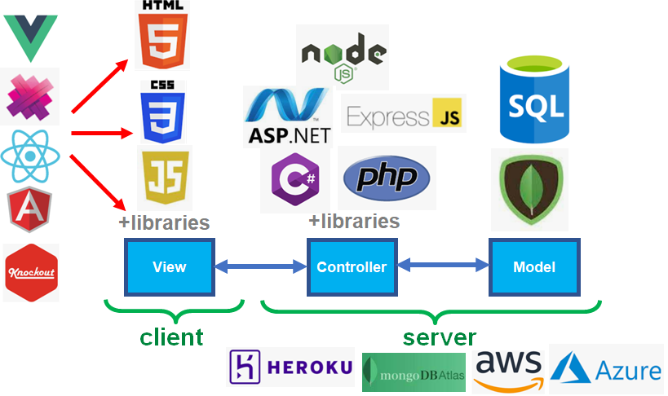
MVC ARCHITECTURE

Slide 14
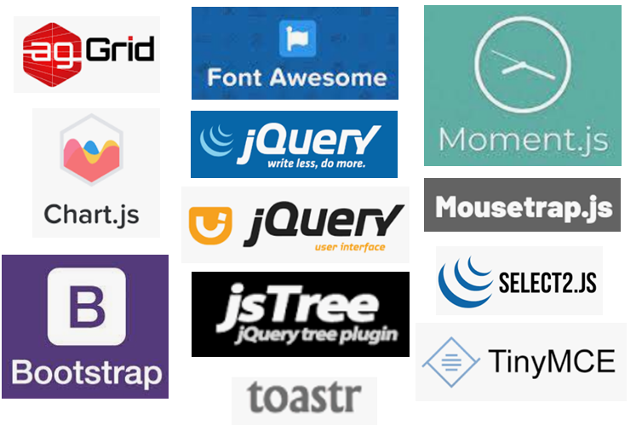
JAVASCRIPT LIBRARIES

Slide 15

POPULAR SPA FRAMEWORKS
The 3 most popular frameworks are Angular, Vue, and React.
Angular is an ‘opinioned’ framework that forces developers to adopt a known and well-regarded approach.
Vue is similar to React because it focuses on the view and uses HTML templates with data and behavior injected attributes and directives.
React was made by Facebook and is now the most popular framework for constructing complex front-end applications.

Slide 16
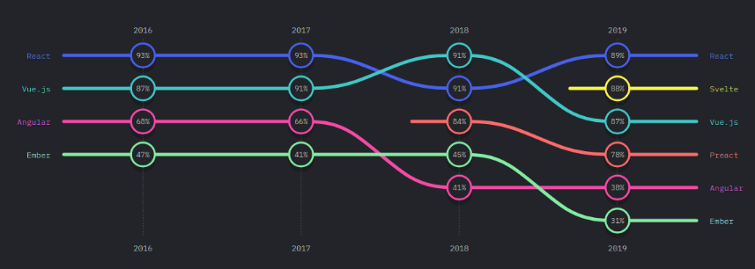
FRAMEWORK PREFERENCES

Slide 17

MEMORY LEAKS
Memory leaks are the result of not cancelling subscriptions when a component was un-mounted.
These subscriptions can include DOM event listeners, web socket subscriptions, event aggregators, or API requests.

Slide 18
VUE

Slide 19
VUE SUMMARY
Vue was created in 2014 by an engineer who worked on Angular, and decided to make it liter weight and easier to use.
Many of the principals discussed on Vue are also used by other frameworks like Angular and React.
Generates the HTML by compiling templates into virtual DOM render functions, and intelligently figures out the least amount of components to re-render when the app state changes.

Slide 20
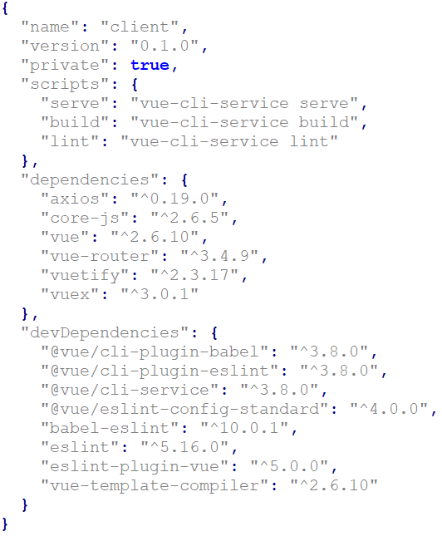
PACKAGE.JSON
The package.json file is used to define the libraries installed, their dependencies, and their version numbers.
When a new library is installed using npm install, this package.json file is updated.
This file is often associated with node.js and is located at the root folder.

Slide 21
NODE MODULES
The node_modules folder is used to store all the files of the libraries installed. This can include jQuery, vuetify, vue cli, axios, …etc.
This folder is often found on the client folder and server folder.
This folder can take the largest amount of memory, and it is recommended to delete those folders empty when sending the project file on git.
The files are recovered when a developer types npm install, where the libraries and version numbers are fetched from the package.json file, downloaded, and fully restores the node_modules folders.
The npm install command has to run on the client and server folders.

Slide 22
MASTER DIV AT INDEX.HTML
The very start of any framework is a very basic index.html file with the standard DOCTYPE, <html><body><head> notation and includes a single <div> in the body with a unique id assigned to it.
This div is where all components are generated on the app.
The app will never redirect to a different .html to load a new page, it will just regenerate the HTML inside this master div.

Slide 23
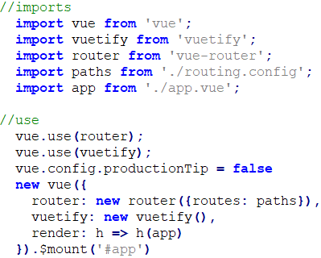
MASTER MOUNT AT MAIN.JS
The next component is a .js file that mounts vue into this master div tag.
Other parts of vue can be attached to this div as well, such as routers, paths, UI libraries,…etc.

Slide 24
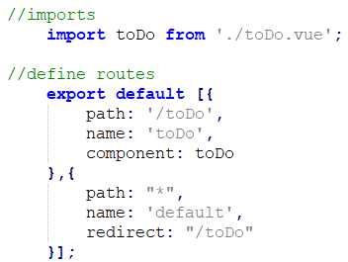
ROUTER
The router is used to re-generate the elements of the master div, based on the parameters passed on the URL.
It’s essentially used to navigate through different pages of an app.

Slide 25
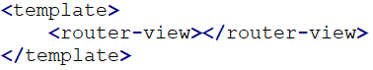
START AT APP.VUE
Once the master div and mount have been established, the last part to start building the app is adding an app.vue file with the syntax shown below.
The router will use this as a gateway for the component pages that are listed on the router.

Slide 26
COMPONENTS
Once all of the above is complete, components are now ready to be designed.
Components can be any element of an app, it can be a page, a dialog, a utility, a custom dropdown,…etc.
In some frameworks, components are created with a .js and .html file component but in Vue, only a single file .vue is required. This .vue file has both JavaScript and HTML inside.
The HTML is wrapped around a <template> tag and the JavaScript is wrapped around a <script> tag.

Slide 27
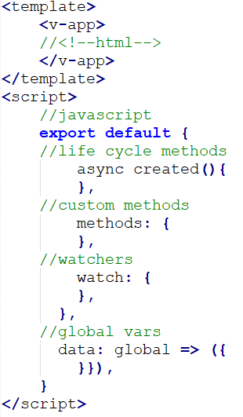
COMPONENTS
The JavaScript is handled with a master object, where functions and variables are assigned. This setup is similar to REACT.
In other frameworks like Aurelia, the JavaScript is broken down by imports, injections, constructors, and a body that allows for traditional JavaScript functions.
The body could have slight differences in syntax compared to vanilla JavaScript, such as removing the ‘function’ syntax from function callouts.

Slide 28
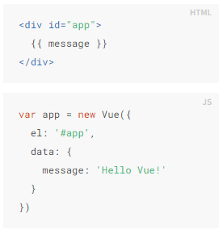
DECLARATIVE RENDERING
Declarative rendering is the process of displaying variables on HTML.
Traditionally, this was done with document.getElementById(“someId").innerHTML = “some content” but with the Vue framework, it is done with {{}} as shown.
Global variables are often defined in the data field.

Slide 29
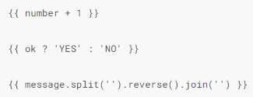
RENDERING LOGIC
Not only can variables be displayed but also JavaScript functions as shown.
Template logic is usually limited to one line and is not used to write elaborate JavaScript functions.
Common examples of these are for instance, showing ‘Add’ instead of ‘Edit’ on a button, if the item was not yet populated.

Slide 30
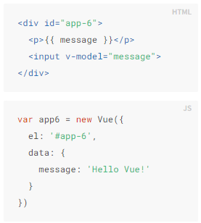
BINDING VALUES TO INPUTS
Variable values can be assigned to input controls like textboxes.
In this way, when a user enters a value on a textbox, that value can be used to do logic in JavaScript as a variable.
To achieve this, the v-model syntax is used.

Slide 31
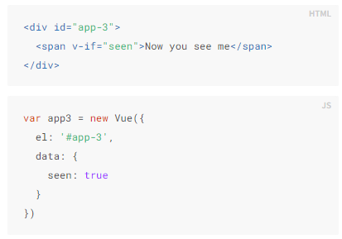
CONDITIONAL RENDERING
Conditional rendering is the process of binding variables to HTML elements. If the variable is truthy, the element will display, if it is falsy, the element will hide.
Traditionally, this was done with document.getElementById(“someId").style.display = "none" but with the Vue framework, it is done with v-if as shown.

Slide 32
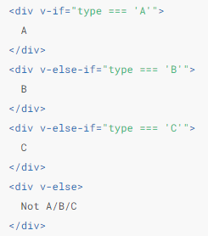
IF ELSE CONDITIONALS
A complete if-else can be applied on the template as shown.
On the provided example, if variable type is ‘A’, ‘B’, or ‘C’, that value will display, otherwise it will display ‘Not A/B/C’.

Slide 33
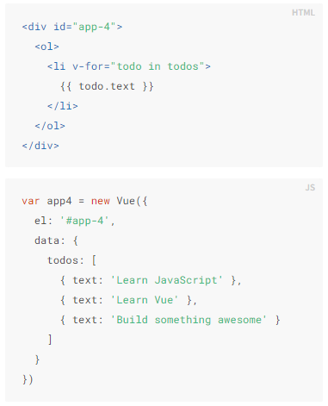
LOOPS / REPEATERS
Repeaters are frequently used when an array of values needs to be displayed on the page accordingly.
This would be very tedious to do this with vanilla JavaScript.
To achieve this, the v-for syntax is used where the first value is an item inside the second value which is the array to iterate.
To display the values inside, the {{}} declarative rendering is used.

Slide 34
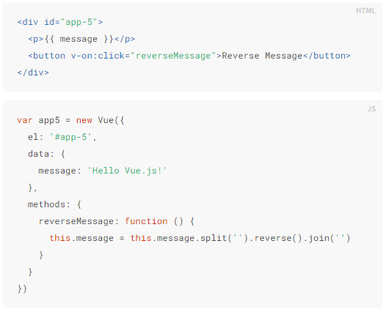
USER EVENTS
User events are defined with v-on: syntax and the function name to trigger as the value.
This can be used to add mouseovers, keypresses, clicks,…etc.
Traditionally, this was done with .addEventListener() and destroying the event on page deactivate.

Slide 35
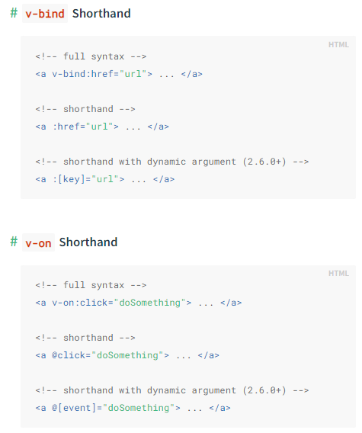
EVENT SHORTHANDS
Shorthands are used to bind variables to attributes, instead of provide hard coded strings.
In Vue, the colon : shorthand is the most common one, and can be used to add bind variables instead of strings.
For instance, instead of setting href to an actual url string, the shorthand :href can be used to assign a variable so that href can dynamically be changed.

Slide 36
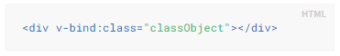
CLASS SHORTHANDS
Shorthands can also be used to define styles and classes to HTML elements.
In this example, “classObject” is not a class name, it is a variable that contains the string of a class name.

Slide 37
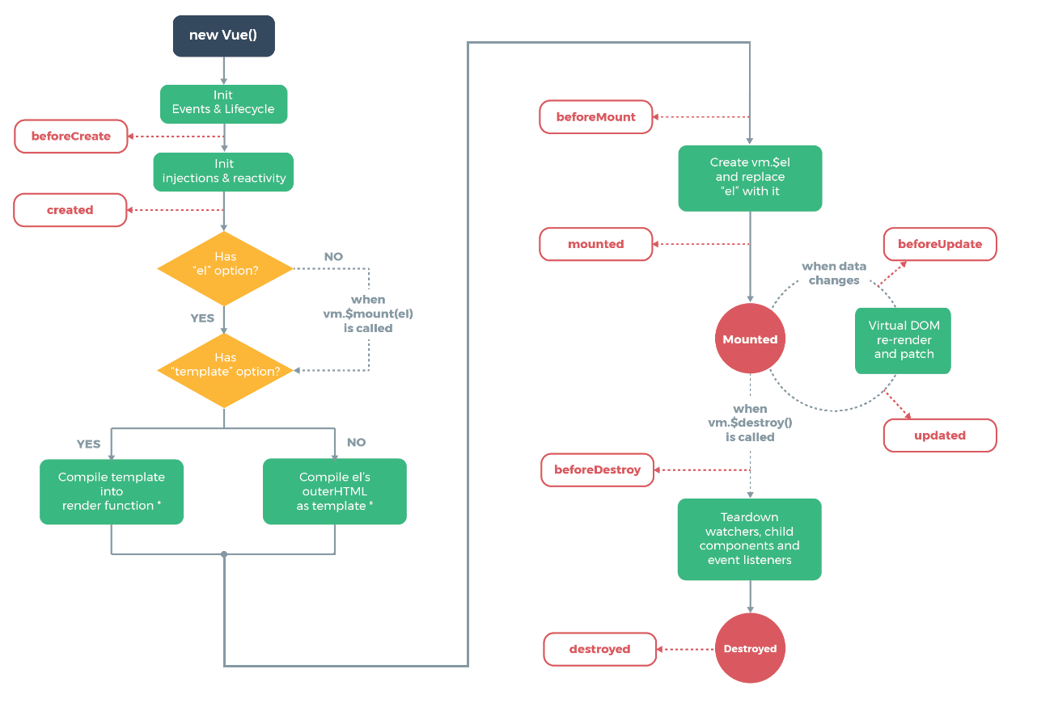
LIFE CYCLE
Life cycle functions are reserved functions that can be declared to run at certain points in the creating and destruction of a page.
Some logic must run at the start of the page, such as fetching data and manipulating it for the frontend. Other logic must run at the end of the page, such as destroying unused events.

Slide 38
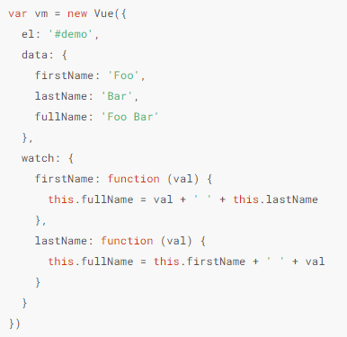
COMPUTED, WATCHED, AND OBSERVED
Computed, watched, or observed variables are used in SPA frameworks to trigger a function whenever they are changed.
An example use case of this is with date pickers, where formats need to be converted on change.
The differences between each are not that significant, but relate to whether their values are cached and when they are executed.

Slide 39
REACT

Slide 40
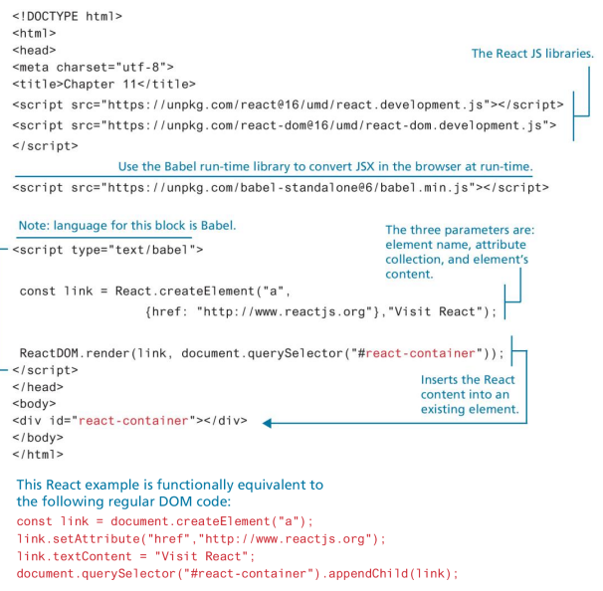
INTRODUCTION
React is the most popular framework as of 2022 and is similar to Vue, but uses JSX(JavaScript XML) syntax.
An example difference is that JSX requires className instead of class to assign a CSS class.
One unique element of React is that it has the ability to give control on what is updated on the view, something that other frameworks don’t always provide.
It can be installed with either a direct link or an npm install just like Vue.
React documentation can be found at https://reactjs.org/docs/

Slide 41
VIRTUAL DOM
The virtual DOM is a concept where a virtual representation of the UI is kept in memory and synched with the real DOM in library such as ReactDOM. This process is called reconciliation.
React also uses fibers to hold additional information about the component tree. These fibers are used to enable incremental rendering of the DOM.

Slide 42
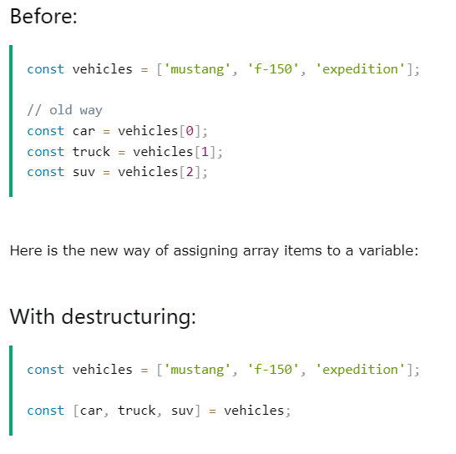
DESTRUCTURING
Destructuring is a way to assign array values to variables.

Slide 43
MASTER DIV
The master div in React is defined with id=‘root’.
This is where React builds the entire page using its powerful engine based on the components you created.

Slide 44
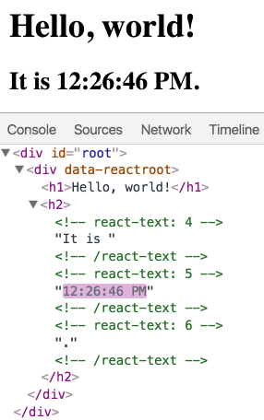
REACT REACTS
React only updates what is necessary.
In the example shown, the date is the only element that changes.
Because React is immutable(once created, it can’t be changed), the only way to make updates is by re-running the render() function or use states i.e. setState().

Slide 45
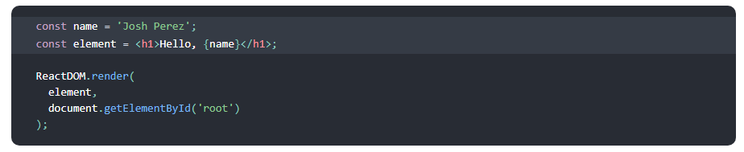
DECLARATIVE RENDERING
In JSX with React, declarative rendering is done with single {} as shown.
As a recap, declarative rendering is the process of displaying a variable or doing math on HTML.

Slide 46
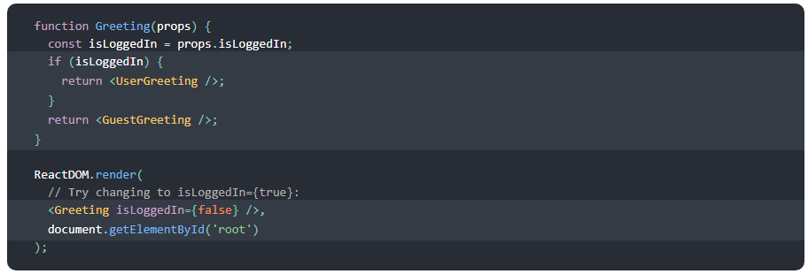
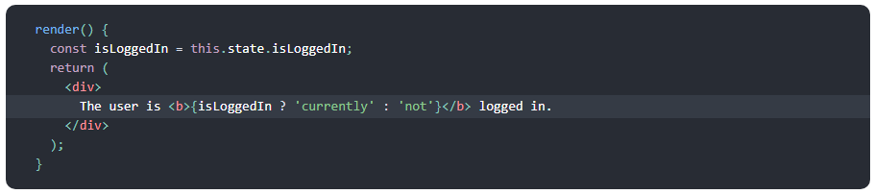
CONDITIONAL RENDERING
Conditional rendering is handled with either JavaScript or ternaries.

Slide 47
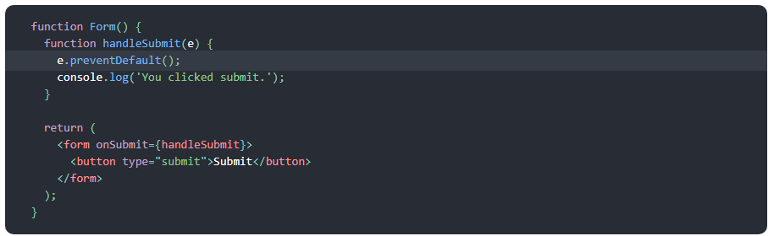
EVENTS
Events can be declared and handled as shown below.
The e argument represents the react event that can include DOM and location properties.

Slide 48
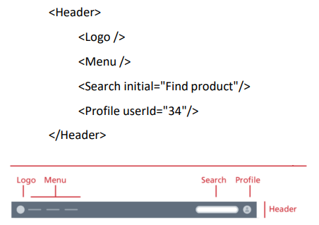
COMPONENTS
For example, a header component can be added using the <Header> tag as shown.

Slide 49
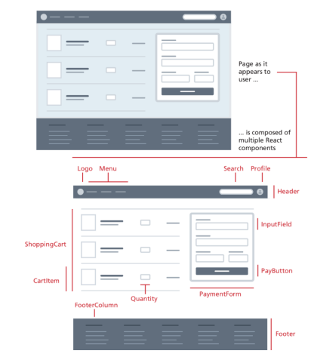
COMPONENTS
A component in React is a block of functionality.
They allow the user to break down a user interface into smaller pieces so they can be reused, combined, and nested together.
Components can either be in the same JavaScript file or imported on a separate file.
There are 2 types of components, functional and class components. Functional components just return JavaScript helpers whereas class components are part of the React framework and can render HTML.

Slide 50
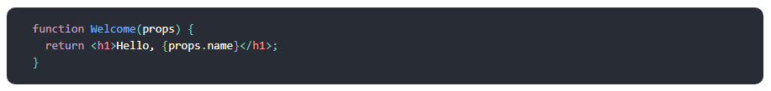
FUNCTIONAL COMPONENTS
The simplest way to create components is to use functions.
Function components contain single params called props.
Props are used for passing data between components.
A functional component can be referenced via markup.
When exporting HTML components, make sure to wrap it around an empty <></> tag, no <div> or <span> tag or anything.
This wrapping is required because can’t return more than 1 element in React.

Slide 51
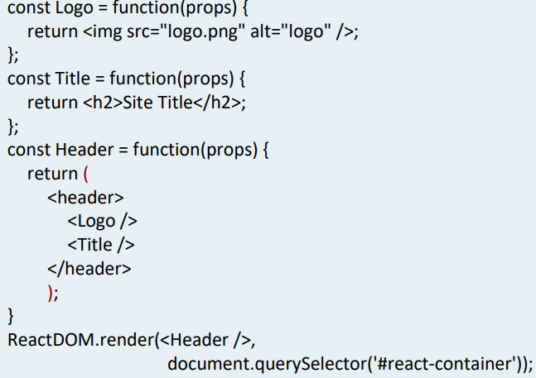
NESTED FUNCTIONAL COMPONENTS
The ability to reference components via markup allows pages to be composed as series of nested components.

Slide 52
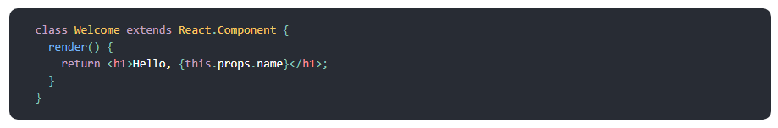
CLASS COMPONENTS
The other more complicated way to create a component is by using classes.

Slide 53
COMPONENT ATTRIBUTES
Components have props, state, and behavior attributes.
Props are used to pass data between components.
States are used for a component to have its own internal data.
Behaviors are used for a component to respond to events.

Slide 54
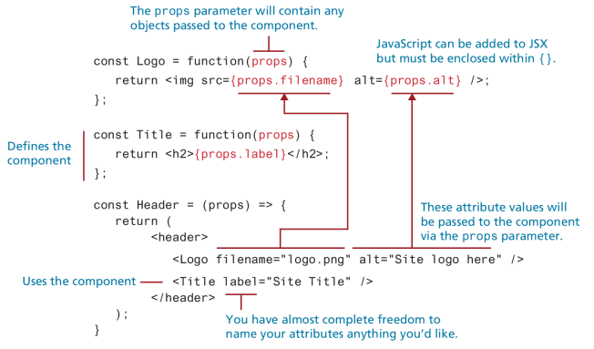
PROPS

Slide 55
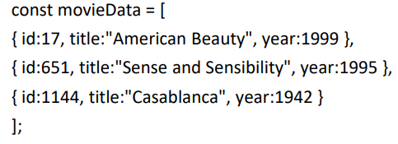
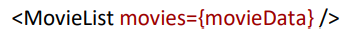
PASSING OBJECTS
An object that is defined as shown:
Can be passed to a component as shown:

Slide 56
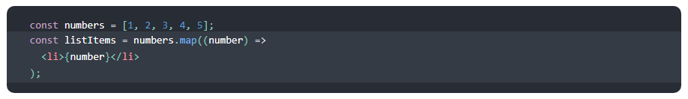
REPEATERS
Repeaters used in other frameworks are often treated with the map() function in React.
The map() function will iterate through each element on the array and build the DOM HTML accordingly.

Slide 57
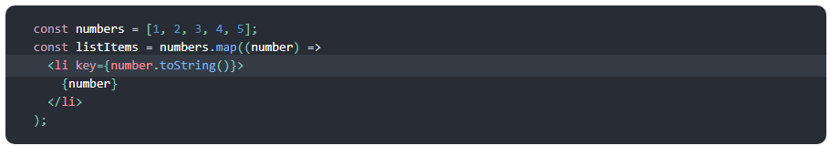
REPEATERS
Similar to repeaters in Vue, a unique key must always be specified when repeating on a structure, otherwise the following error will display: each child in a list should have a unique ‘key’ prop.
To add a key, the syntax below can be used.

Slide 58
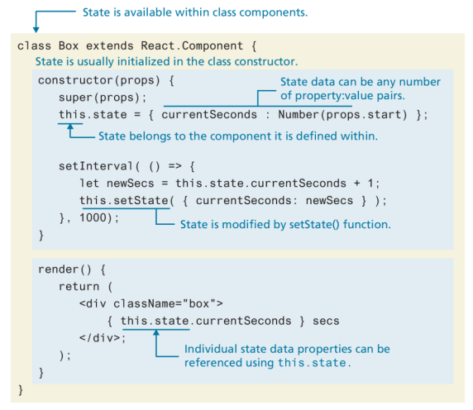
STATE
State is used to make changes to any data in the component.
React reacts to changes made to state changes.
To use state, the setState() function needs to be used. If it is not used, React will not update the DOM if a change was made.

Slide 59
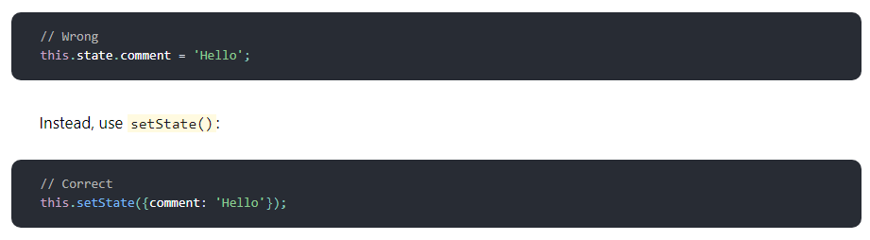
STATE

Slide 60
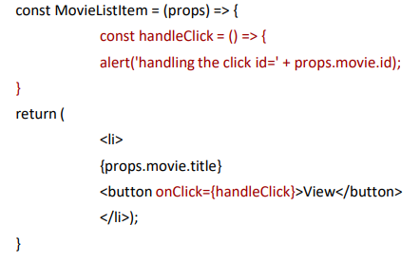
EVENTS
Behaviors and events go hand in hand.
An example is shown here, where an event is applied to a button, and the event is defined on the code.

Slide 61
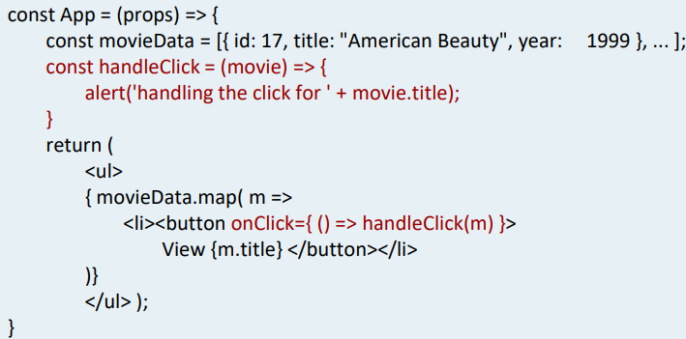
PASSING DATA TO EVENTS

Slide 62
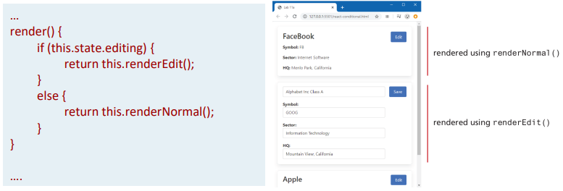
CONDITIONAL RENDERING
Similar to if.binds and v-ifs from other frameworks, React also has conditional rendering, but it is not as succinct.
React conditional renders using standard if-else statements or ternaries.

Slide 63
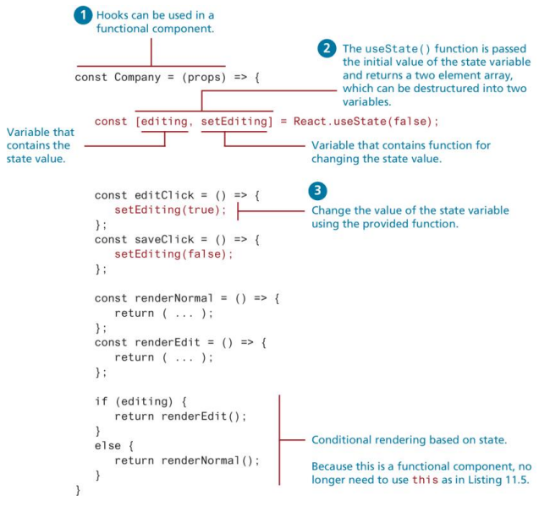
HOOKS
Hooks are a series of reserved components within an SPA framework that can be imported and used for specific functions.
Common react hooks are useRef(), useReducer(), useMemo(), useCallback(), useImperativeHandle(), useLayoutEffect(), and useDebugValue()

Slide 64
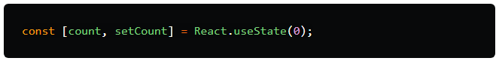
USESTATE() HOOK
UseState() is the most commonly used hook.
The purpose of it is to handle reactive data. Any data that changes in the application is called a state. When any data changes, react re-renders the UI.

Slide 65
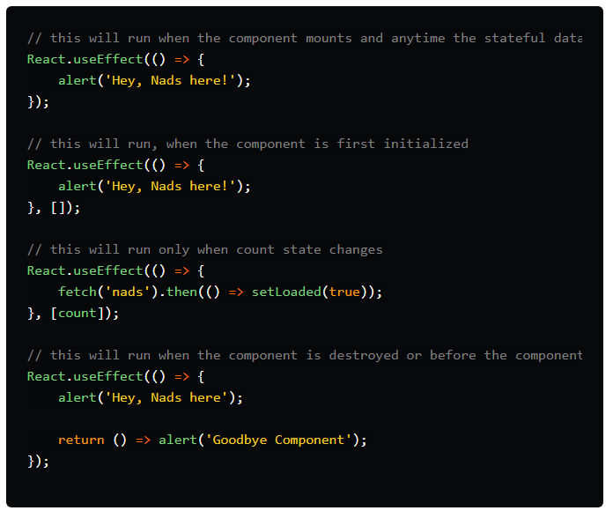
USEEFFECT() HOOK
The useEffect() hook is commonly used to run a function on every render of a function component.
Essentially, it is used to gain access to functions that class components already have such as componentDidMount().
A dev would use this useEffect() to avoid side-effects of using class-based components. For instance, updating the DOM, fetching data from API end-points, setting up subscriptions, or timers.
They are called during mounting and fire on every render.
It’s very important to use this hook carefully, because otherwise a continuous loop can occur.

Slide 66
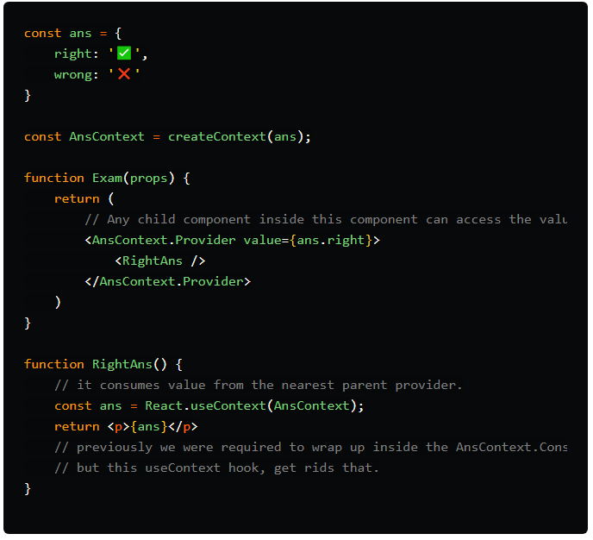
USECONTEXT() HOOK
The useContext() hook is used to share data within it’s component tree without using props.
It removes prop-drilling.

Slide 67
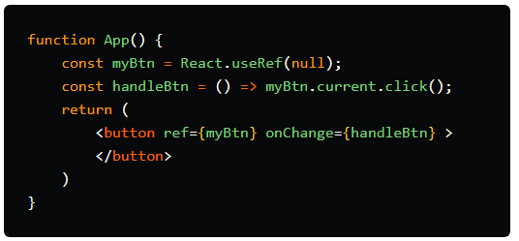
USEREF() HOOK
The useRef() hook is used used to fetch data without causing a re-render like useState().
An example is to grab HTML data from the DOM.

Slide 68
INPUT DATA BINDING
React needs a way to fetch data from user inputs and access them in a JavaScript file so that further processing can be programmed.
There are 2 ways to accomplish this data binding process sometimes called form states, by using controlled form components and uncontrolled form components.

Slide 69

CONTROLLED FORM COMPONENTS
Controlled forms bind data using the REACT state hook component.
The this.state object is used to set global variables that are assigned to different input controls on the app.

Slide 70

CONTROLLED FORM COMPONENTS

Slide 71
UNCONTROLLED FORM COMPONENTS
Uncontrolled forms bind data using a special ref() object that interacts with the DOM nodes.
Handler methods are not required using this method.
An example ref object might look like this.symbol = React.createRef().

Slide 72

COMPONENT DATA FLOW
Different components need to pass data to each other for an app to work properly.
In React, data usually belongs to the parent, so in this example, it belongs to the App component.

Slide 73

COMPONENT DATA FLOW
The diagram shows the interactions of events and data that would need to occur for an app to work properly.
The flow of data will be limited by the parent-child relationship and use the following attribute methods dataFromParent(), dataFromChild(), and the parentCallback() method to trigger an event on the parent component.

Slide 74

COMPONENT DATA FLOW

Slide 75

LIFE CYCLE
Similar to Vue, React also offers life cycle functions but not as many as many other mainstream frameworks.
The render() function is triggered when the component is mounted.
The componentDidMount() is called after the render() function is called.

Slide 76

ROUTING
Similar to Vue, React also offers routing.
Routing is unique in SPAs because a single page is used to build the app, there are no hyperlinks to redirect to a completely new page.
The React Router package is required to configure these routes.

Slide 77

ROUTING
The <Link> tag can be used to replace hyperlinks to redirect.

Slide 78

ROUTING

Slide 79

CSS IN REACT
An external CSS file can be imported in React using import ‘./style.css’ syntax.
The MUI library is the React equivalent of the Vuetify library to Vue, and it uses the sx property to apply inline styles.
Style components can also be used as shown.

Slide 80
BUILD TOOLS
Build tools are used to manage and export the code base.
It handles dependencies and other repetitive and complex tasks such as:
Run transcompilers (JSX to JavaScript, TypeScript to JavaScript, SASS to CSS)
Bundle files together into a single file or split a single large file into smaller files.
Minify CSS and JavaScript.
Create development or production builds.
Run testing tools.
Listen for folder changes and run build tools.

Slide 81

BOILER PLATES
Boiler plates are templates to set a starting point when building an app.
The create-react-app is a popular boiler plate that can be easily installed to build a simple Hello World React application.
https://github.com/facebook/create-react-app

Slide 82
ANGULAR

Slide 83

EXAMPLE STRUCTURE

Slide 84
DIRECTIVES
Directives are used to add additional functionality to a template just like in Vue and React.
In Angular, *ngIf is used for conditionals, and *ngFor is used for repeaters.

Slide 85

COMPONENTS
Each component contains a .css, .html, .ts, and .spec.ts file.
These files can be created automatically using ng generate component nameOfComponent.
When a component is created, it will automatically be added to the app.module.ts.

Slide 86

PIPES
Pipes are used to easily format values on an HTML template.
An example pipe might be <h4>{{ product.price | currency }}</h4>.
Pipes are universal amongst many SPA frameworks.

